Slide 1
1

Slide 2
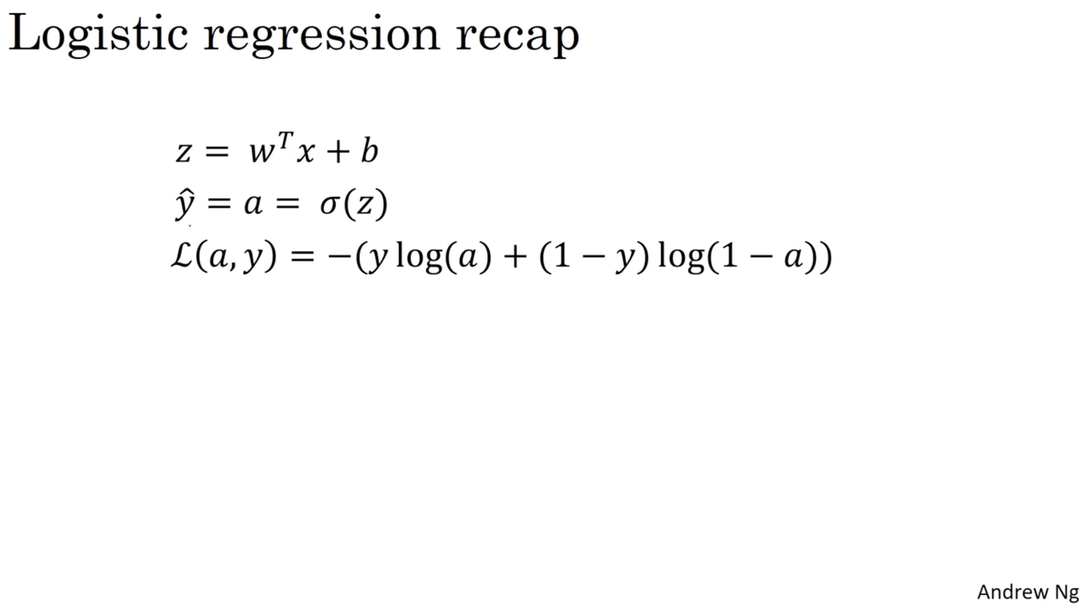

Slide 3
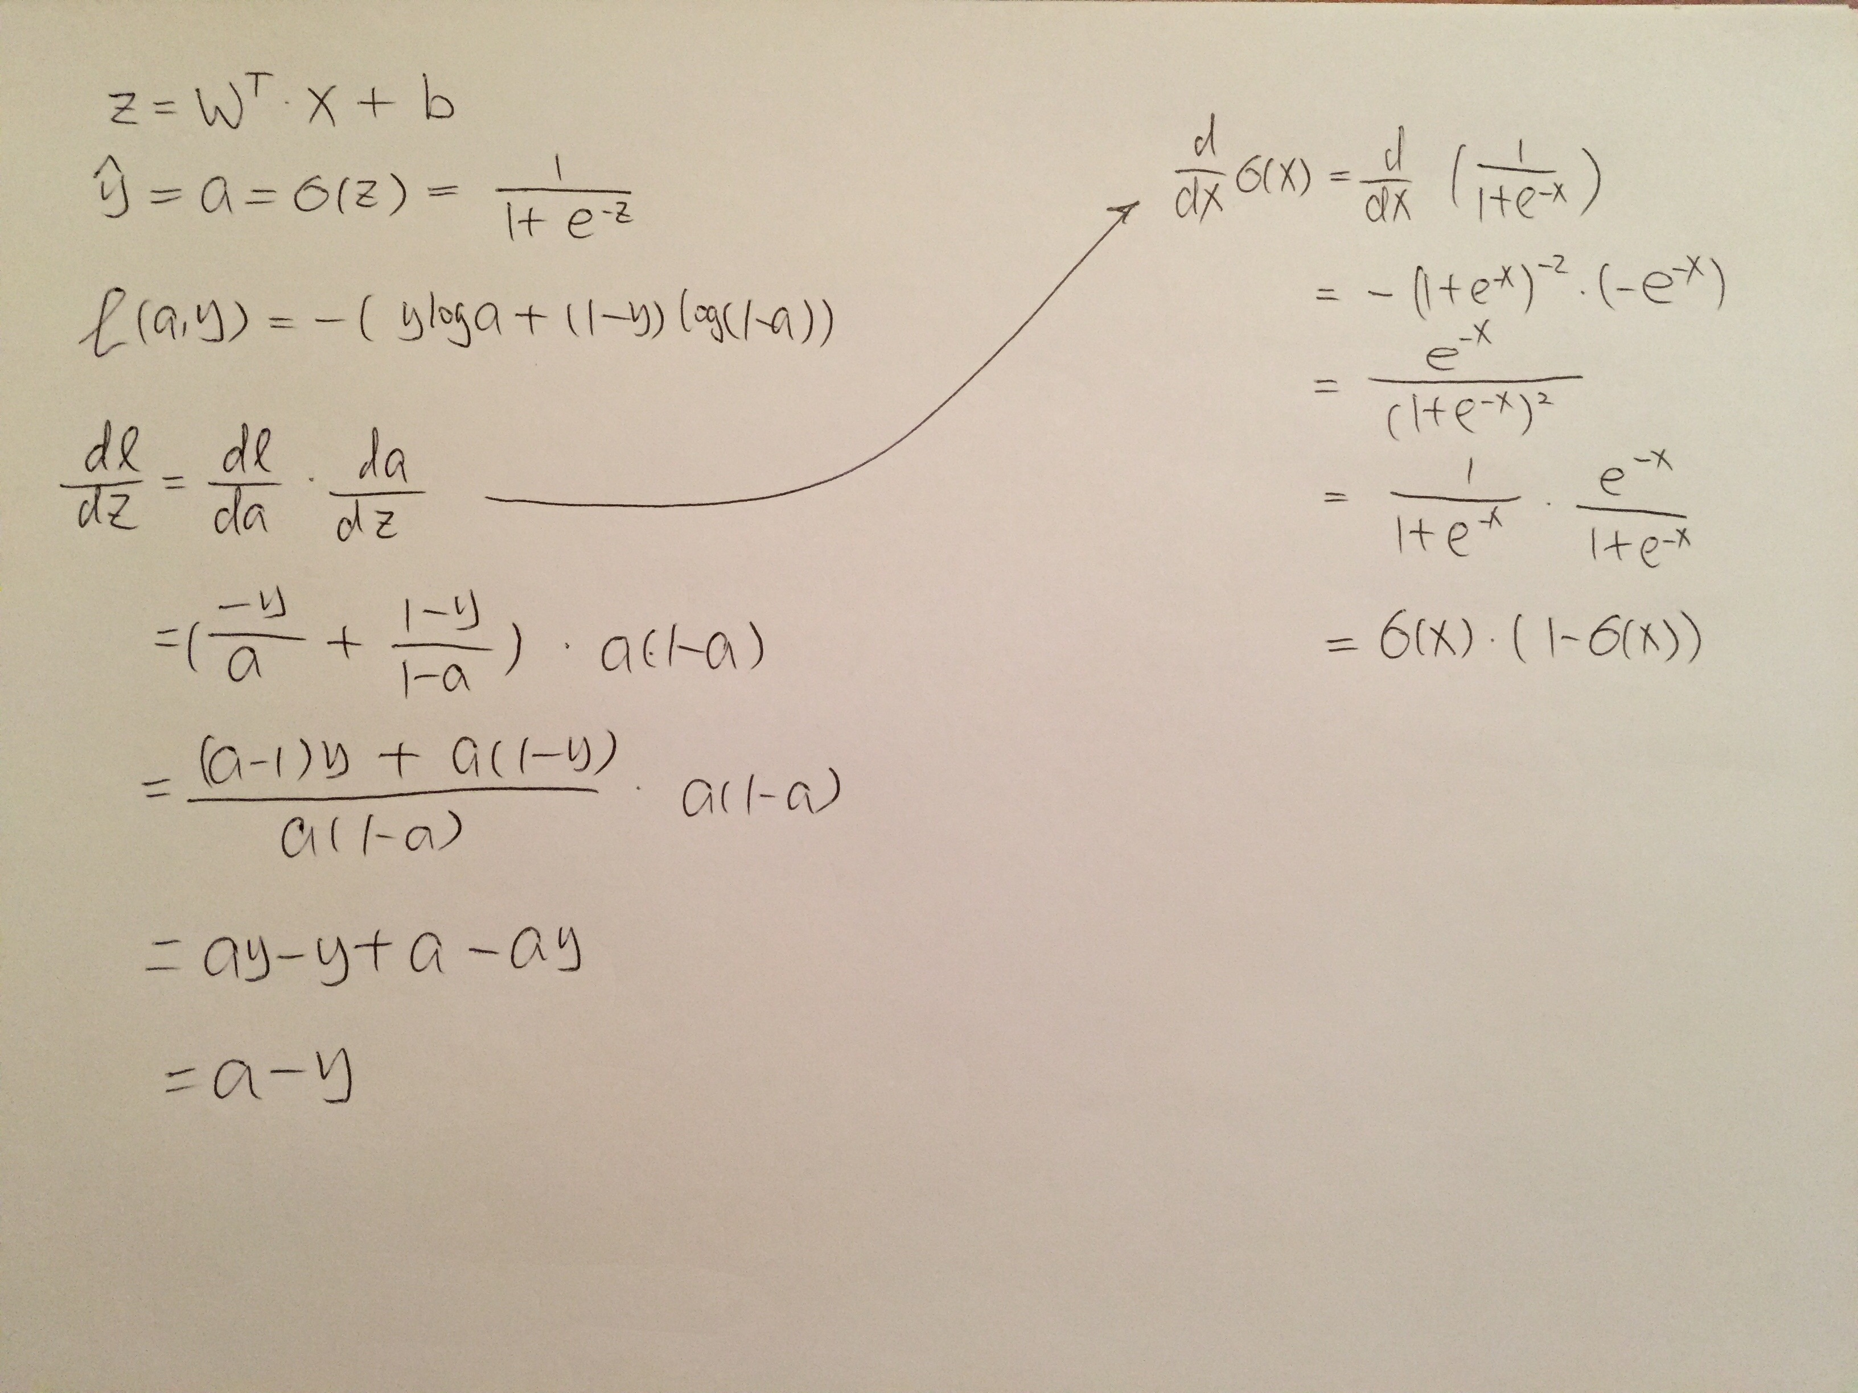

Slide 4
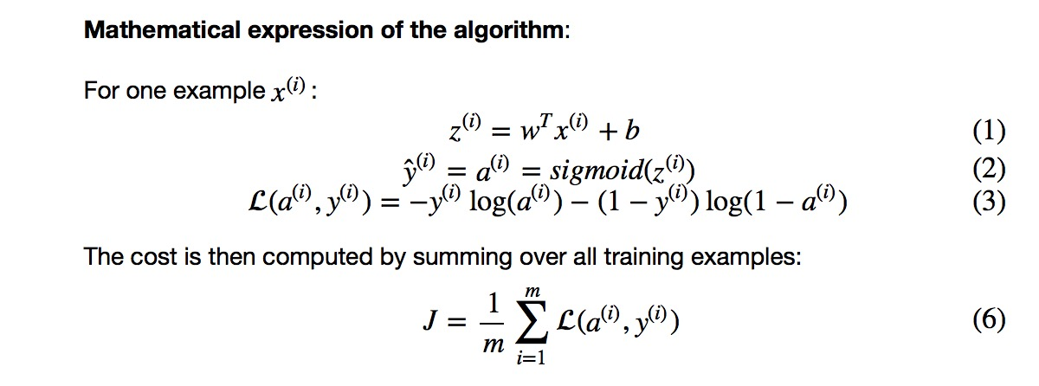
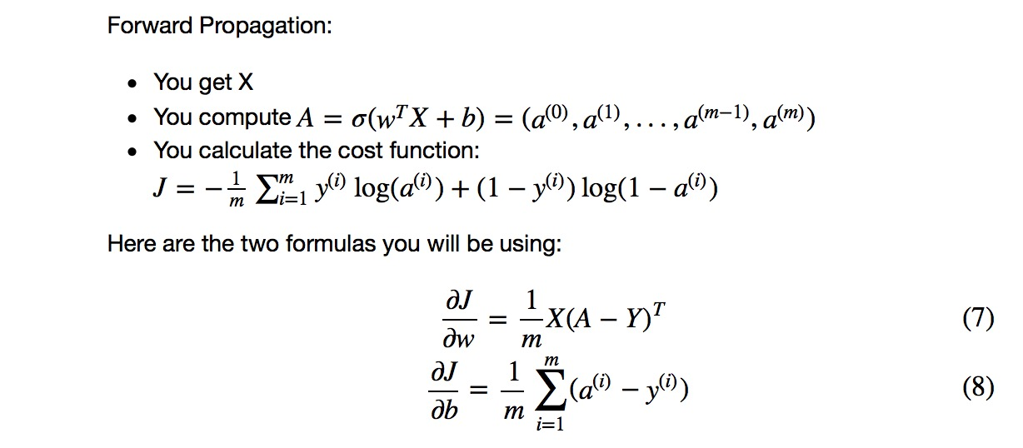

Slide 5
2

Slide 6
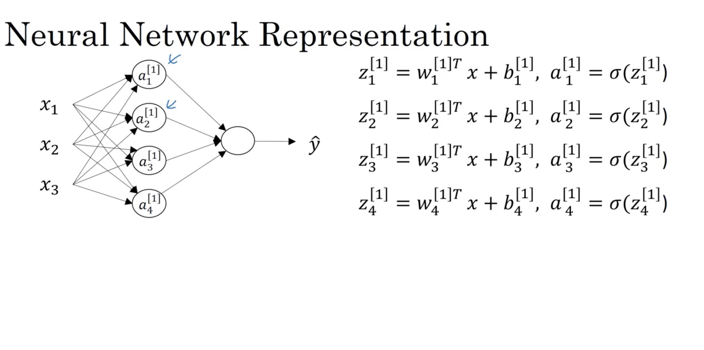
x^{(i)}: (n_{x,} 1)
X: (n_{x,} m)
p node
z^{[1]} / a^{[1]}: (p, 1)
Z^{[1]}/ A^{[1]}: (p, m)
W^{[1]}: (n_{x}, p)
b^{[1]}: (p, 1)
B^{[1]}: (p, m)
In formula we don’t have T, so it is different from vectorization
W^{[L]} (N^{[L]}, N^{[L-1]})
b^{[L]} (N^{[L]}, 1)
z^{[2]} / a^{[2]}: (1, 1)
Z^{[2]}/ A^{[2]}: (1,m)
W^{[2]}: (p,1)
b^{[2]}: (p, 1)
B^{[2]}: (p, m)

Slide 7
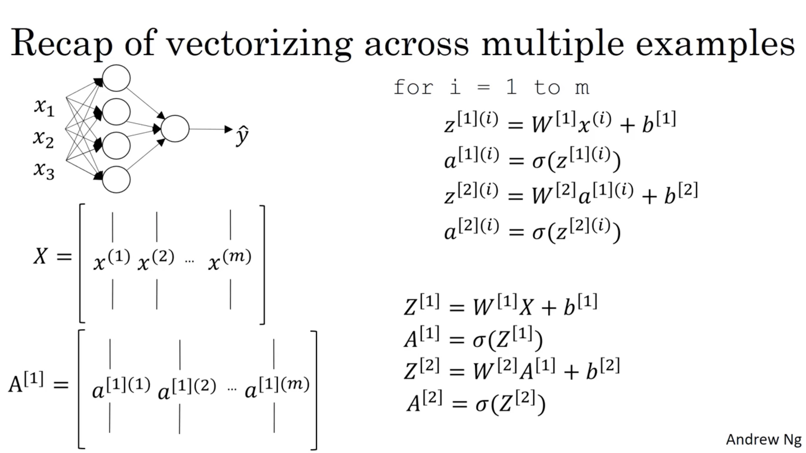

Slide 8
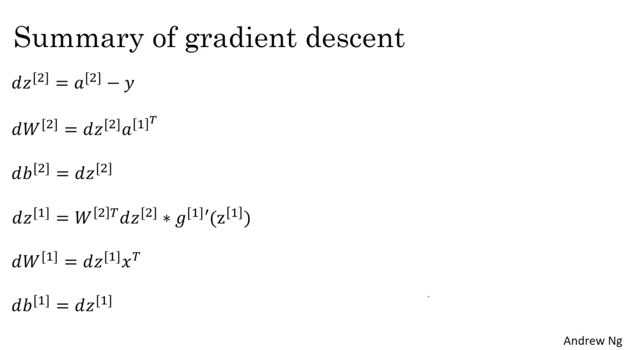

Slide 9
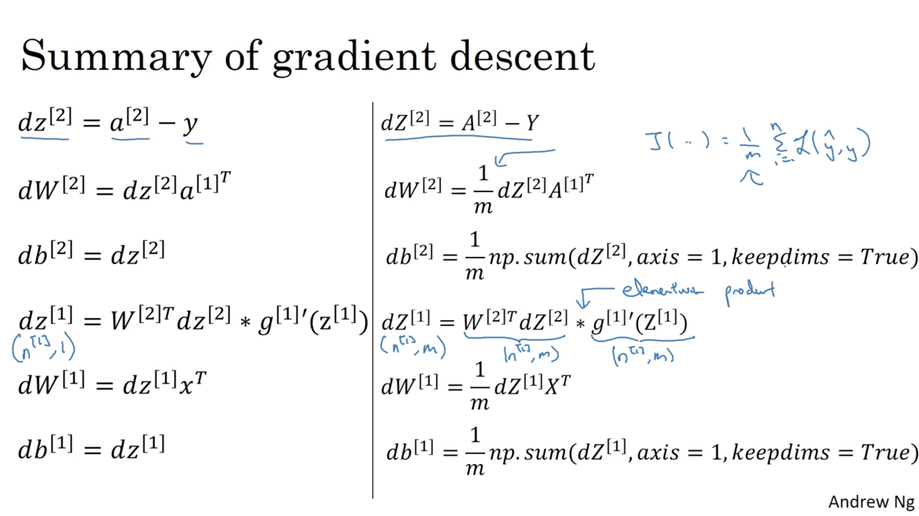

Slide 10
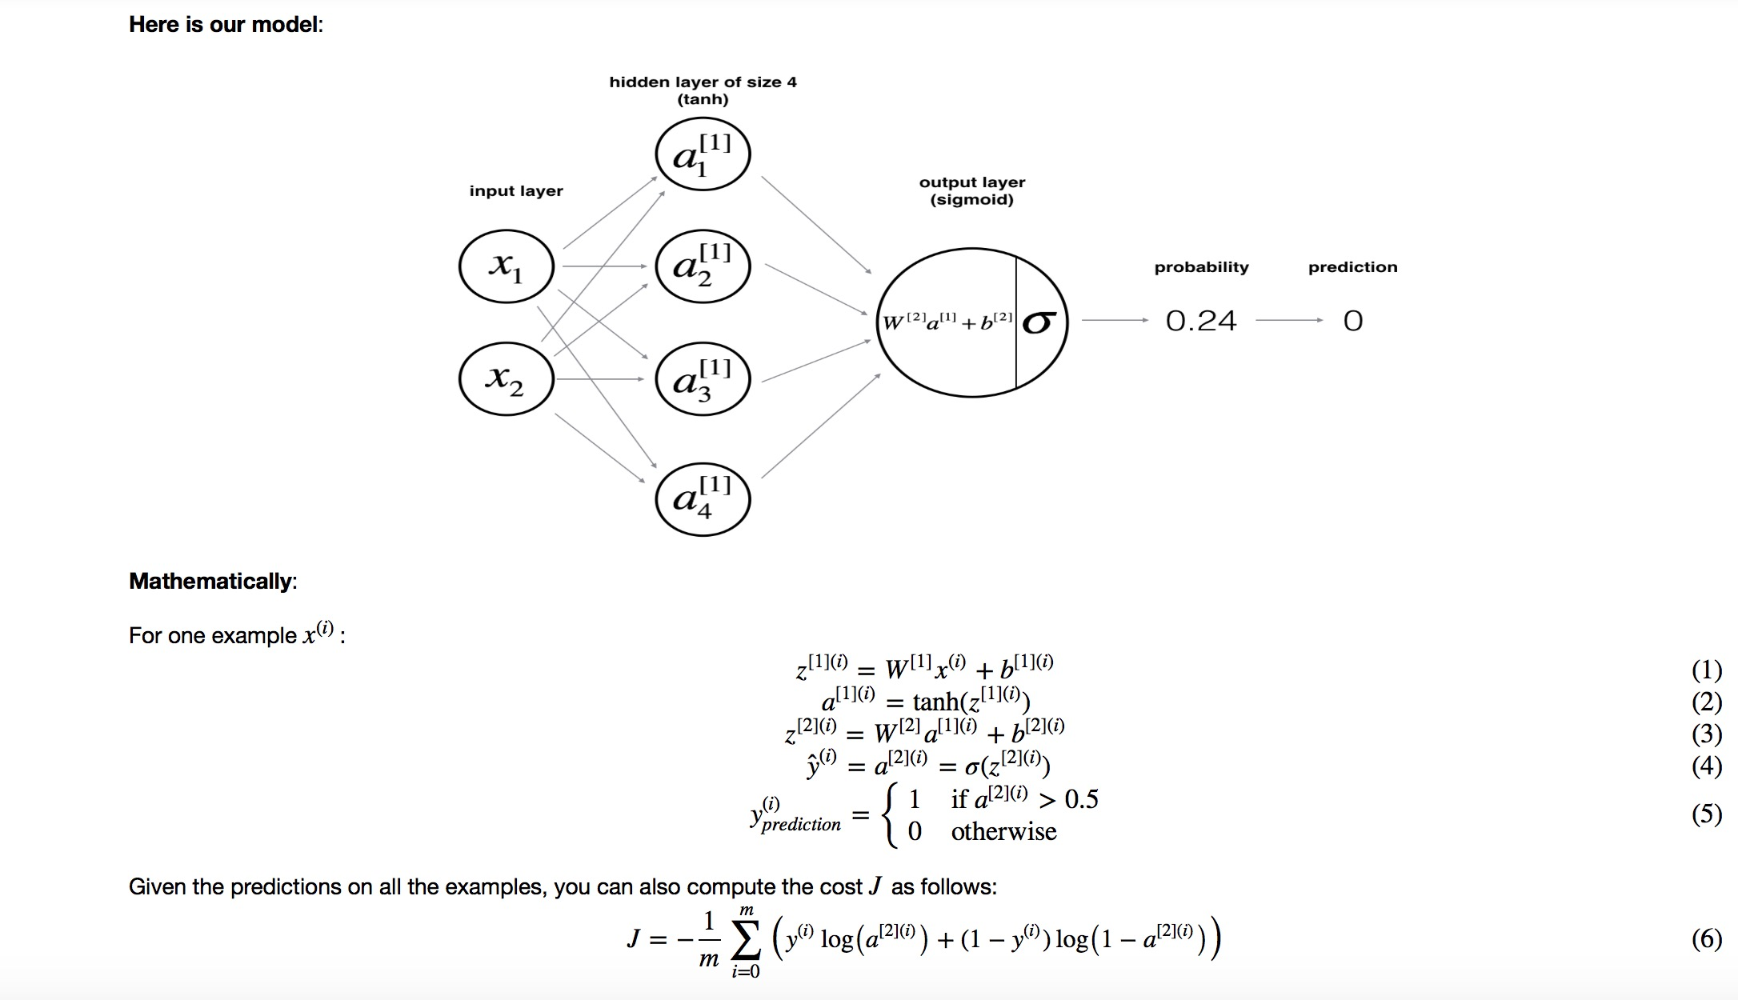

Slide 11
N

Slide 12
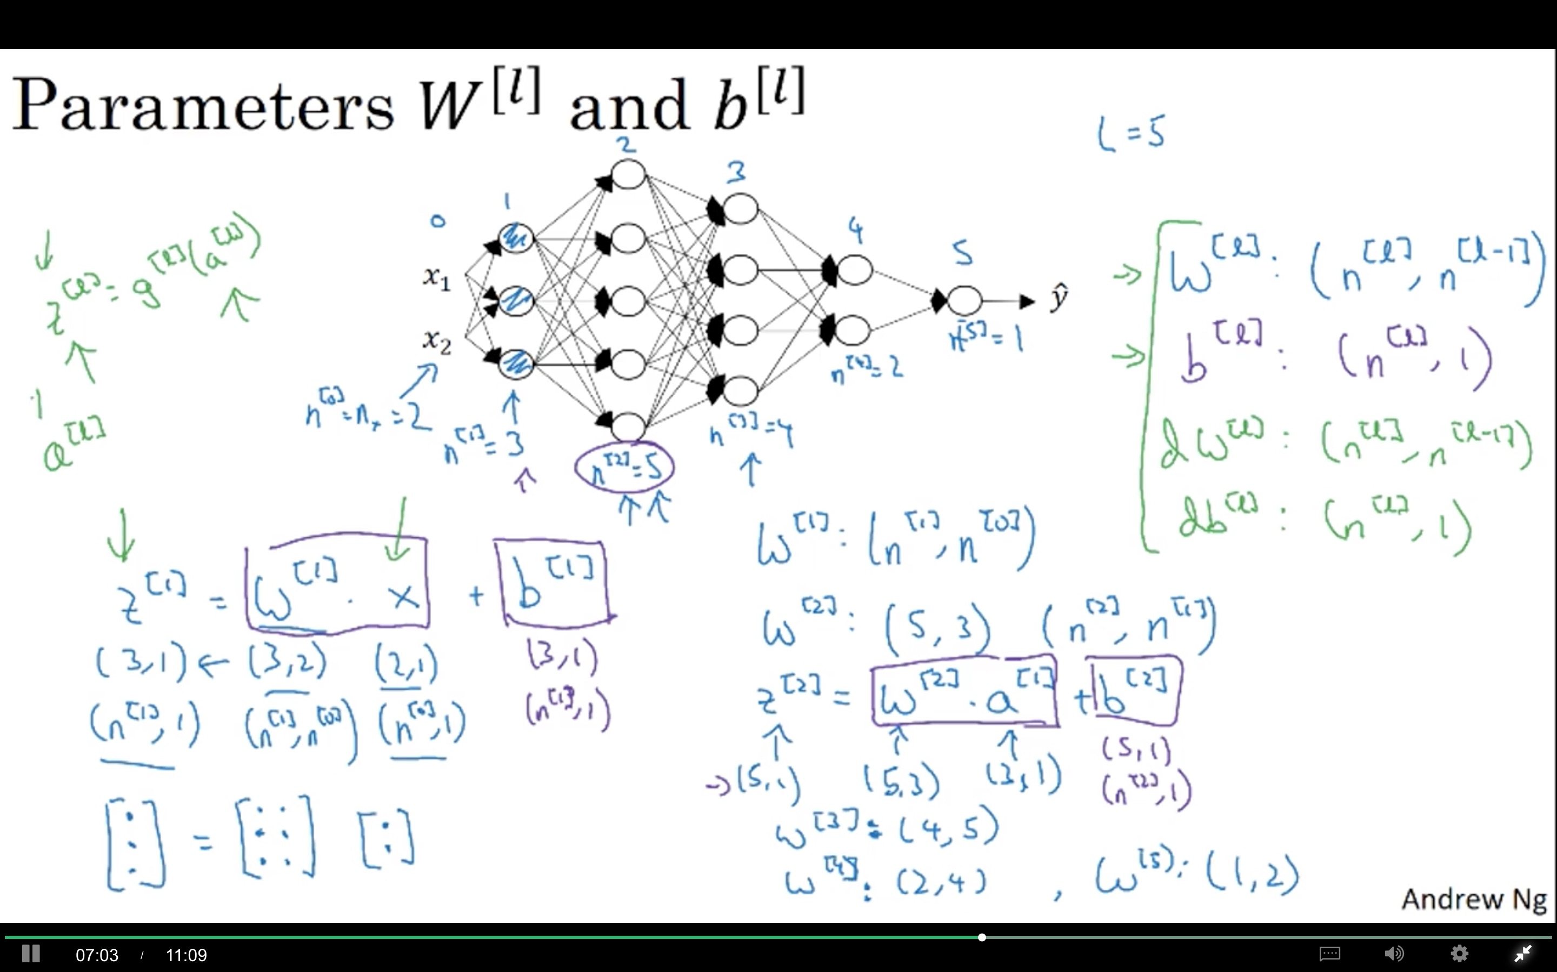

Slide 13
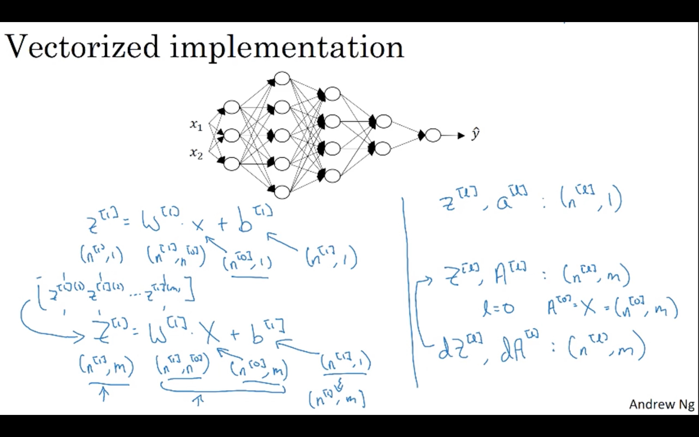

Slide 14
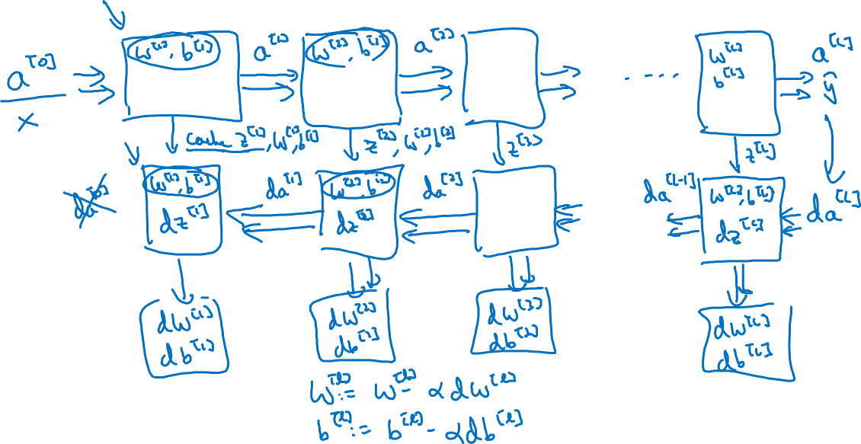
Forward and backward functions

Slide 15
